Slide 1
Forget Me Not
Byron Griggs

Slide 2
Motivation
Everyone loses things, but some people are particularly forgetful
Losing something can cost you
Time
Money
Opportunities
Existing Products
Warning system

Slide 3
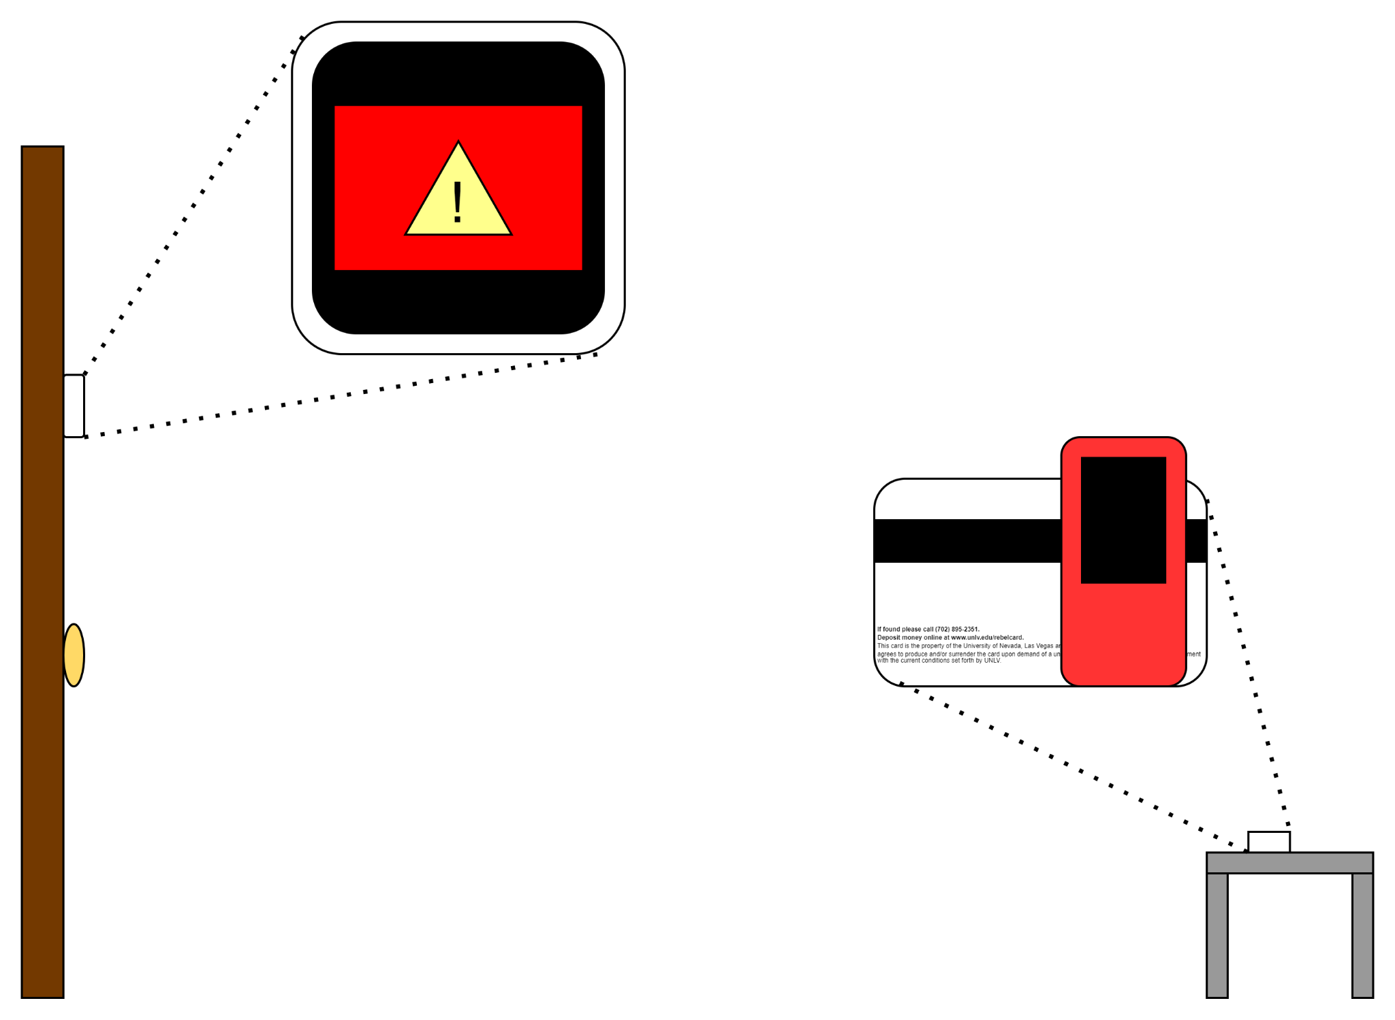
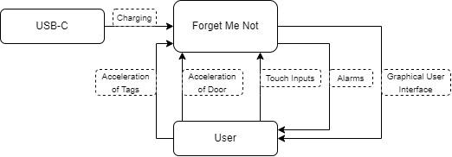
Proposed Solution
IoT tracking system
Uses BLE
Reminds user automatically

Slide 4
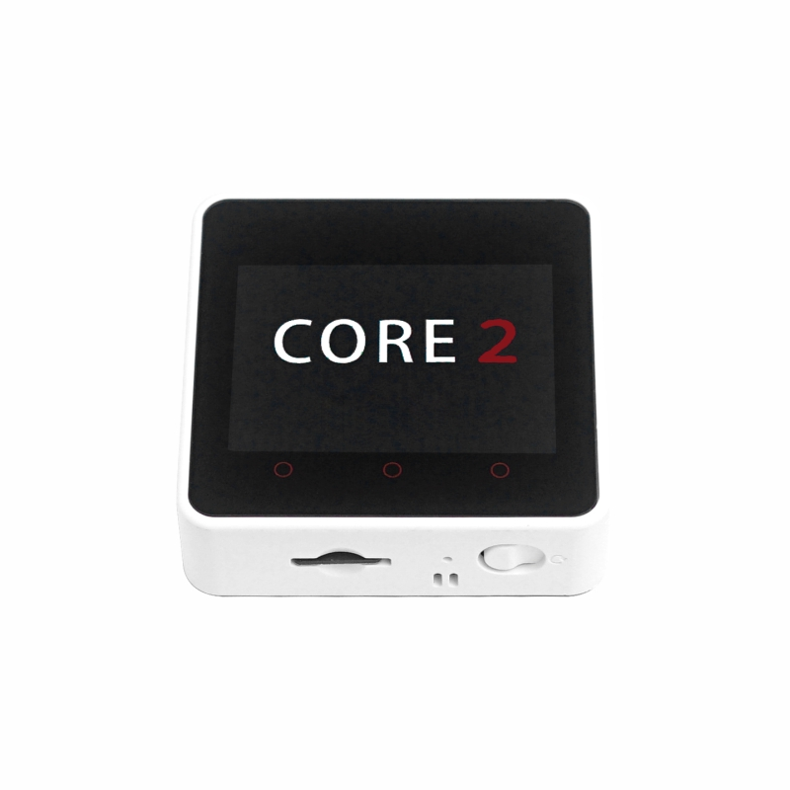
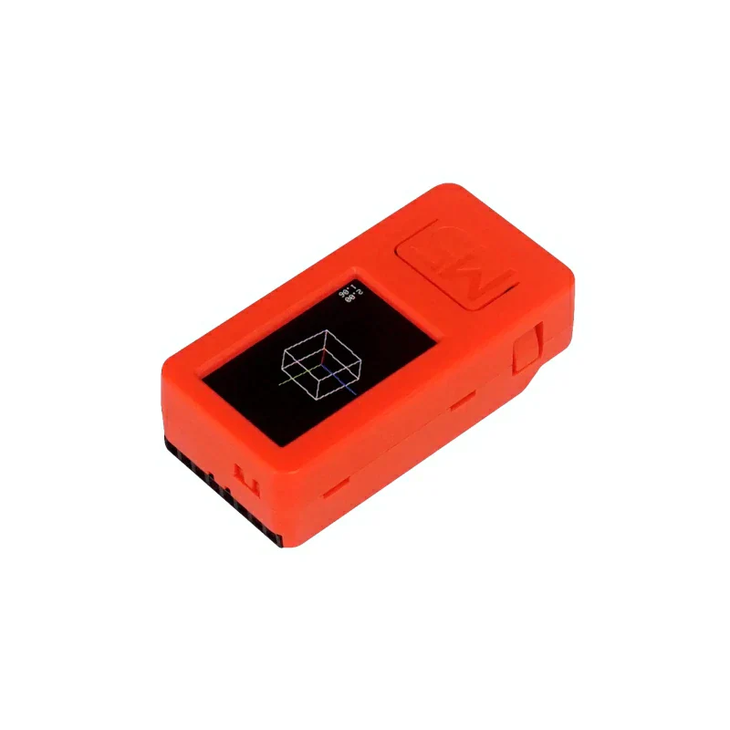
Major Components
BLE
Wifi
ESP32 Processor
M5Stack Core2
M5Stick C-Plus x3

Slide 5
Results
~26m range
Passes through solid objects
xxxxxxxxxxxxxxxxxxxxxxxxxxxx

Slide 6
Improvements
Charging/battery life
Wifi support
Permanent logging
Improved logging GUI
Improved movement algorithm

Slide 7
Conclusion
Fills niche in the market
Needs polish
Functions as intended

